Slide 1

A SIMPLE CALCULATOR USING KOTLIN IN ANDRIOD
RAJU YERIPILLI
PRIYADARSHINI INSTITUTE OF TECHNOLOGY & MANAGEMENT

Slide 2

AGENDA
How create simple calculator
Feature of calculator
​How to develop the app
Steps to develop the code
And simple calculator
Result

Slide 3

How create simple calculator
Since we’ll be building a Calculator app, let’s Pick a Scope that’s not too complicated foe learning but also not too basic for covering different aspects of creating an app

Slide 4

Feature of calculator
Add, subtract, multiply, divide
Support decimal values
Calculate percentages
Invert values
Reset functionality
Format larger numbers
Output resize based on length

Slide 5

How to develop the app
“
”
This calculator app comes and we develop in android studio app

Slide 6
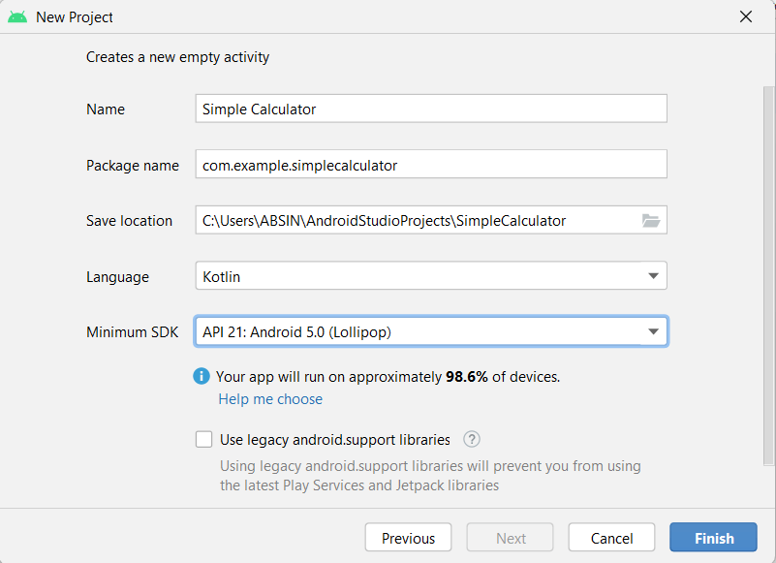

Following steps to develop
Step 1:
Create a new project and select an empty activity

Slide 7
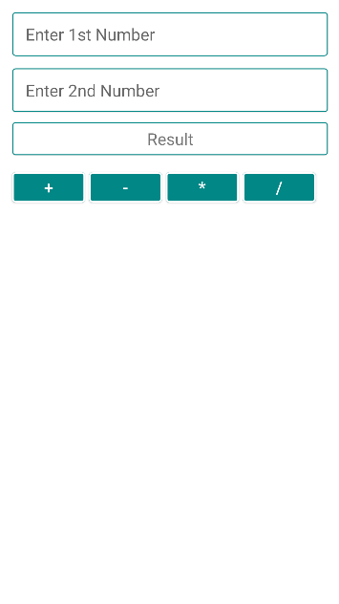
Step 2:

Slide 8
Step 3:

Slide 9
THANK YOU
RAJU YERIPILLI
20GK1A0424
rajuyaripilli@gmail.com

